Slide 1
1. Infrastructure as a Service (IaaS)
2. Platform as a Service (PaaS)
3.Software as a Service (SaaS)

Slide 2
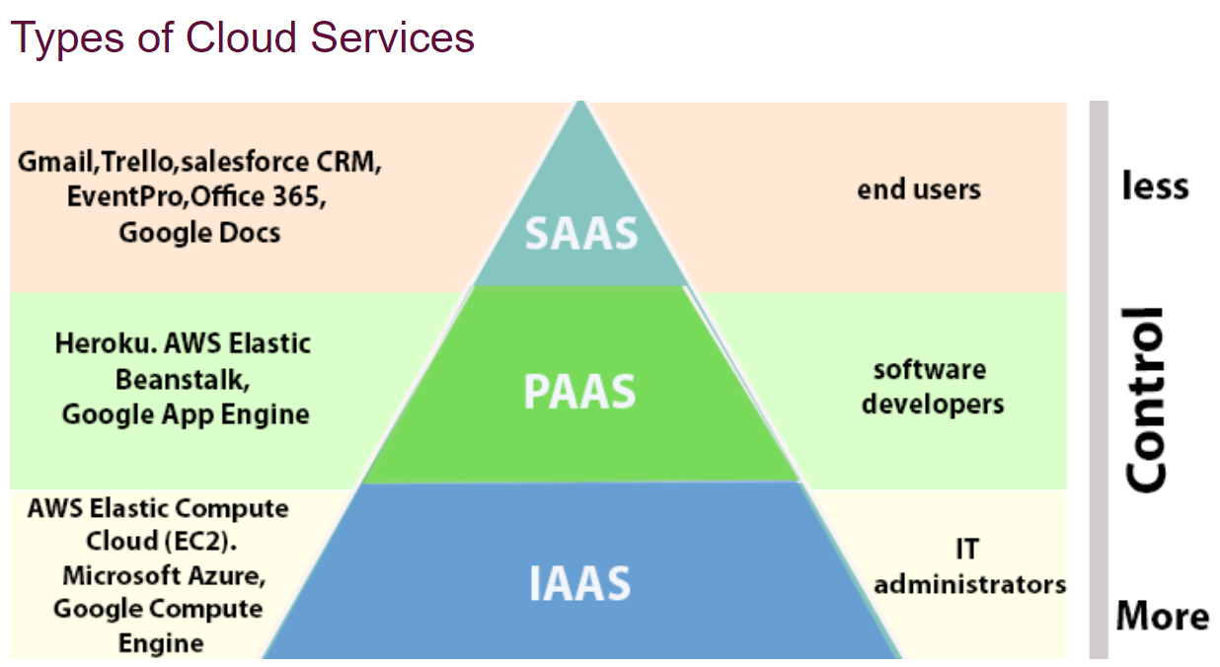

Slide 3
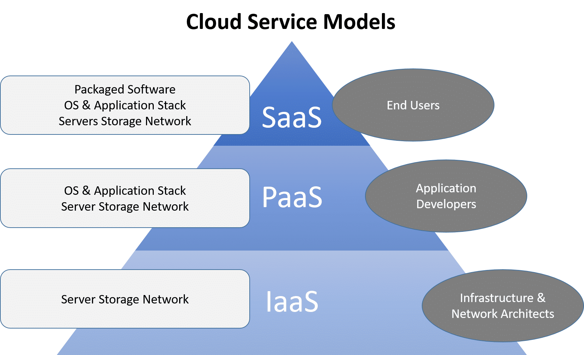
Cloud Computing Models

Slide 4
Infrastructure as a Service (IaaS)
IaaS is the delivery of technology infrastructure as an on demand scalable service.
IaaS provides access to fundamental resources such as physical machines, virtual machines, virtual storage, etc.
Usually billed based on usage
Usually multi tenant virtualized environment
Can be coupled with Managed Services for OS and application support

Slide 5
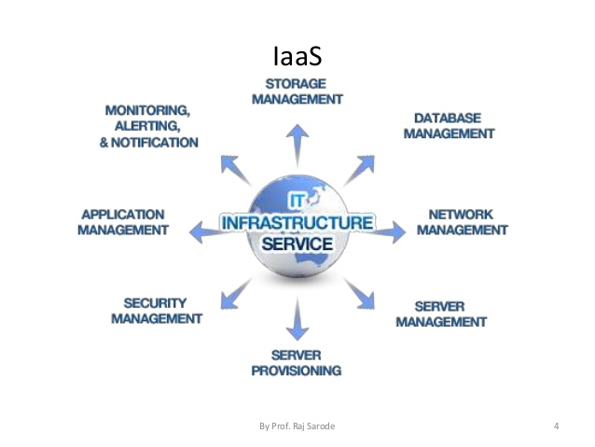

Slide 6
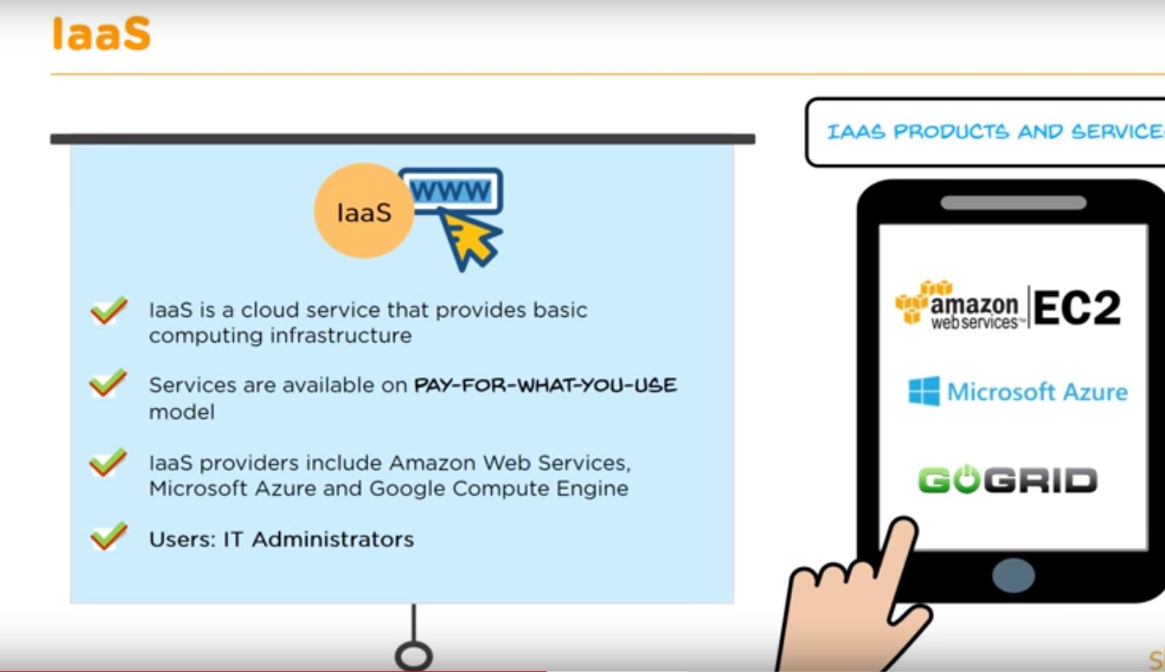

Slide 7

Platform as a Service (PaaS)
PaaS provides the runtime environment for applications, development & deployment tools, etc.
PaaS provides all of the facilities required to support the complete life cycle of building and delivering web applications and services entirely from the Internet.
Typically applications must be developed with a particular platform in mind
Multi tenant environments
Highly scalable multi tier architecture

Slide 8
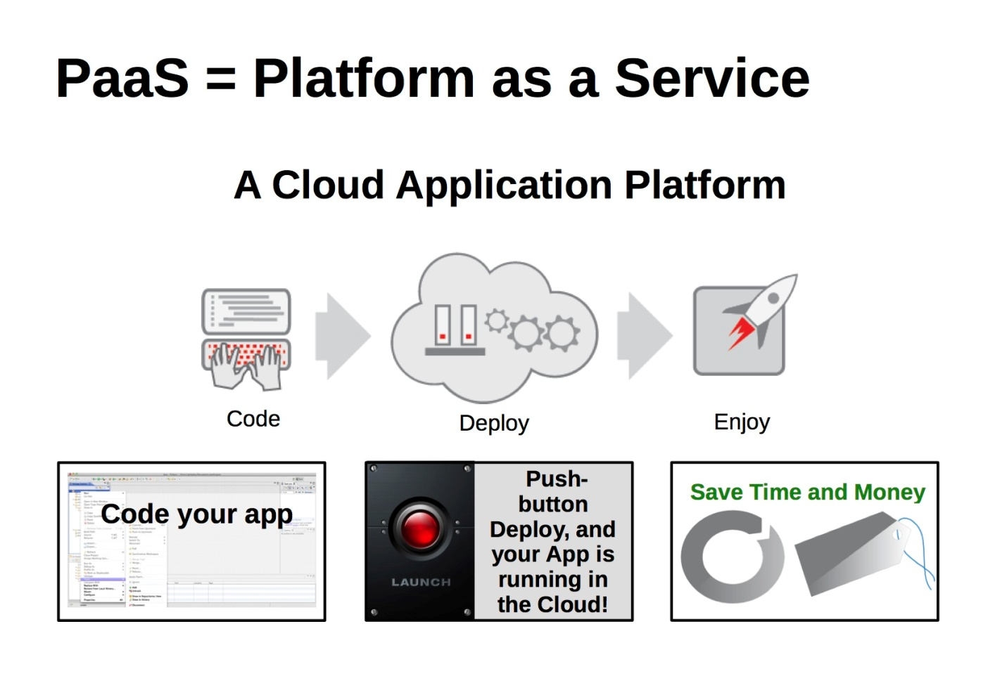
Platform as a Service (PaaS)
Platforms as a service remove the need for organizations to manage the underlying infrastructure (usually hardware and operating systems) and allow you to focus on the deployment and management of your applications. This helps you be more efficient as you don’t need to worry about resource procurement, capacity planning, software maintenance, patching, or any of the other undifferentiated heavy lifting involved in running your application.

Slide 9
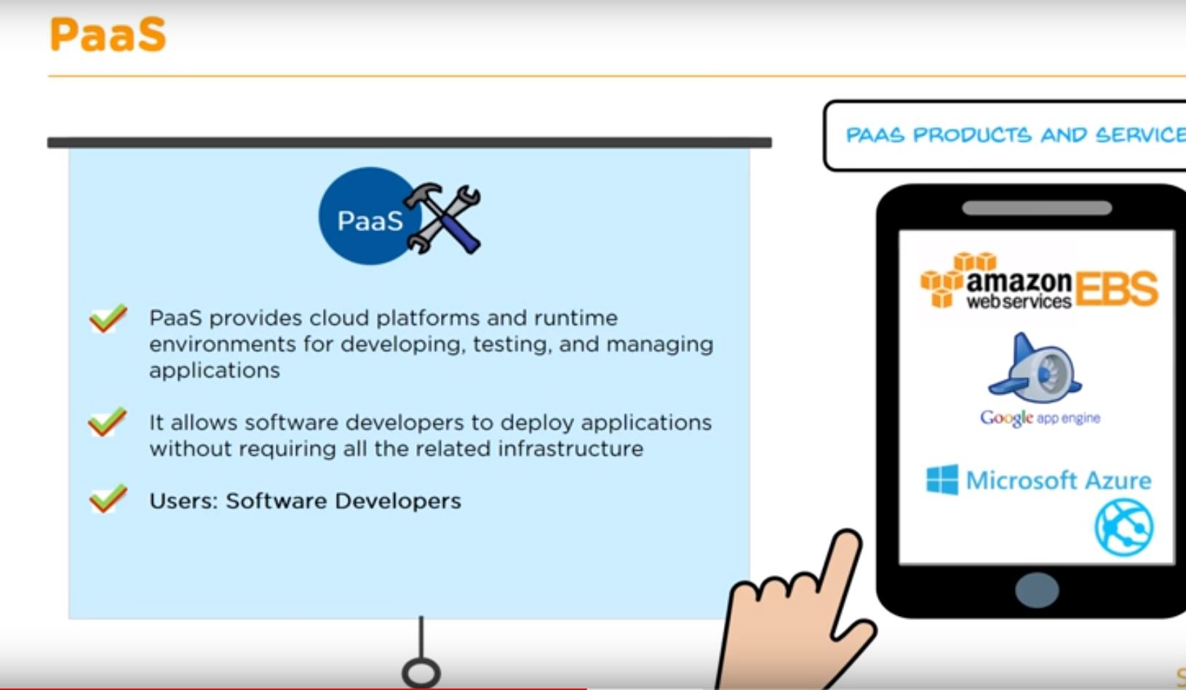

Slide 10
Software as a Service (SaaS)
SaaS model allows to use software applications as a service to end users.
SaaS is a software delivery methodology that provides licensed multi-tenant access to software and its functions remotely as a Web-based service.
•
•
•
Usually billed based on usage Usually multi tenant environment Highly scalable architecture

Slide 11
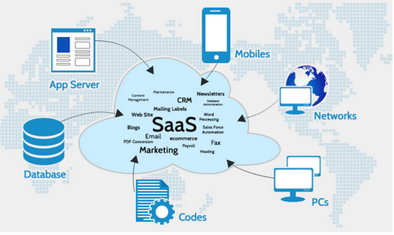
Software as a Service (SaaS)
Software as a Service provides you with a completed product that is run and managed by the service provider.

Slide 12
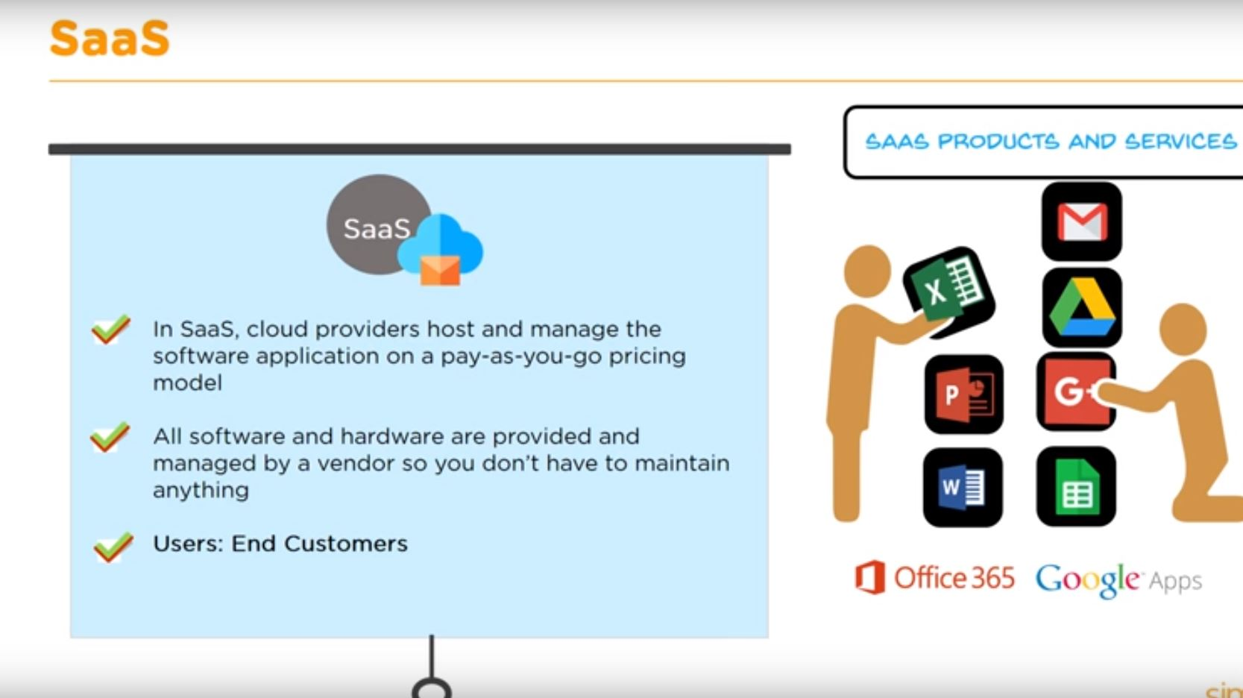

Slide 13
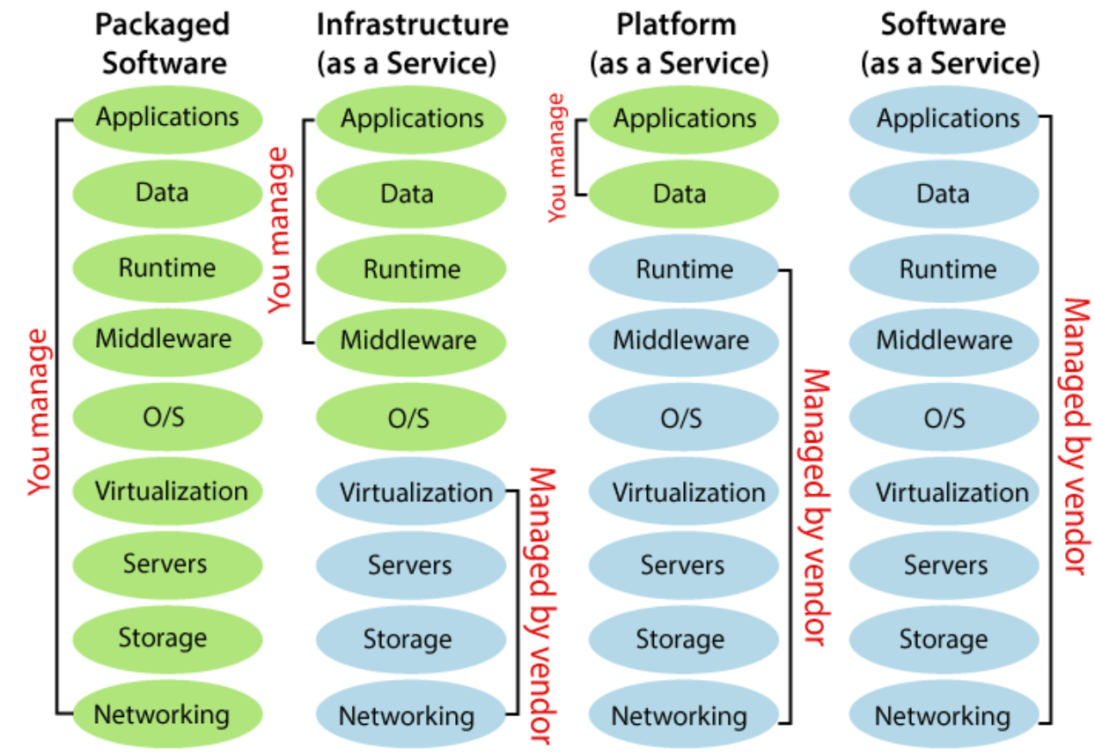

Slide 14
